Slide 1
LAPD
PREDICTIVE POLICING

Slide 2
What exactly does Predictive Policing mean?
Predictive policing refers to the use of predictive analytics based on mathematical models, and other analytical techniques in law enforcement to identify potential (!) criminal activity.

Slide 3
OPERTION LASER
Removing crime from neighborhoods plagued by violence - with
‚laser-like precision‘.
Detected ‚high-risk-people‘
Used ‚crime-scores‘ to determine whether individuals get placed on ‚Chronic-Offender-Bulletin‘
Issues: Public didn‘t know who was targeted by police
-> Individuals were not informed
Individuals were spied on without their knowledge
-> information was put into evergrowing database

Slide 4
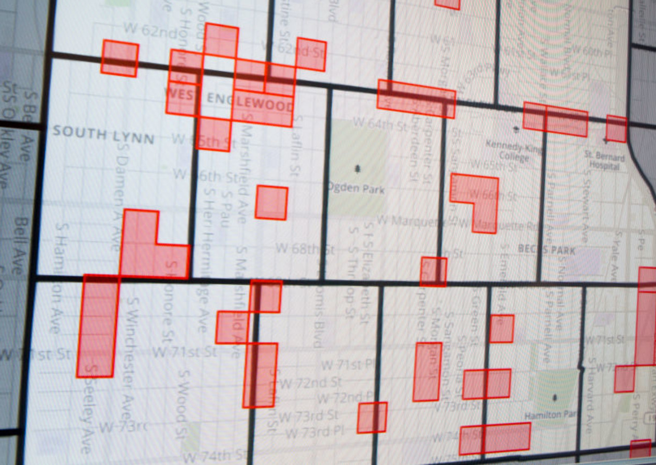
PredPol
Detected ‚high-risk-places‘
PredPol forecasted crime based on patterns from the last several years
Analyzed 3 elements -> crime type + location + time
Spits out 500 x 500 ft hotspots/ boxes
Police officers got new map everyday
PredPol predicted burglaries, car break-ins for the next 12 hours

Slide 5
Drawbacks
Data unable to fulfill fairness-criteria
Automated racial profiling?
-> targeted low-income people and communities of colour
Lack of accuracy
Privacy concerns
Key limitation of any algorithm: Magnifies biases emerging from conventional processes, further intensifying unwarranted discrepancies in enforcement
At systemic level this undermines vital goals of policing such as building community trust

Slide 6
Conclusions
Is it worth taking the risk to discriminate against low-income people, homeless people and communities of colour?
No.
The prediction model is not accurate enough! Even if some numbers in car-break-ins have declined
-> not given that it was due to predictive policing, since it‘s difficult to isolate from other socioeconomic factors

Slide 7
Thoughts anyone?

Slide 8
Sources
https://www.wired.com/story/los-angeles-police-department-predictive-policing/
https://www.latimes.com/california/story/2019-10-15/lapd-predictive-policing-changes
https://www.liberties.eu/en/stories/predictive-policing/43679
https://theintercept.com/2021/01/30/lapd-palantir-data-driven-policing/
https://www.propublica.org/article/bias-in-criminal-risk-scores-is-mathematically-inevitable-researchers-say

